Slide 1

Instructor
Eng. Dalia Morad

Slide 2
Introduction
Excel window
Formatting
Navigation
Basic functions
IF Function

Slide 3
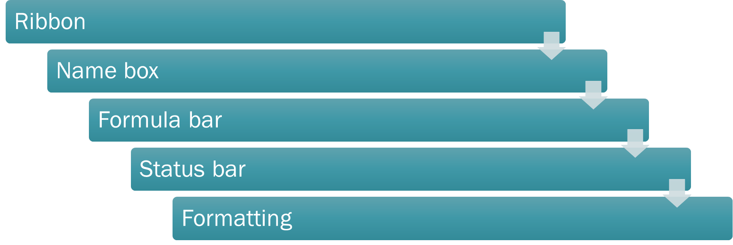
Excel Window

Slide 4
Ribbon
Menu bar

Slide 5

Namebox

Slide 6
Formula bar

Slide 7
Status Bar

Slide 8
Formatting
Cells
Rows & Col
Sheet

Slide 9
Navigation
Arrows
PgUp
PgDn
Home
Ctrl + Home
Ctrl + End
Ctrl + Arrows

Slide 10
Basic Functions
SUM
MAX
MIN
AVERAGE
COUNT

Slide 11
Basic Functions
Cell Reference
Range
Absolute Reference

Slide 12

IF Function
IF(B2>50,”Pass”,”Fail”)

Slide 13
Thank you
Brain Station Academy
Eng. Dalia Morad
Session 1

